Slide 1
Results you can see!
Elbow
Installation Guide
(For Boats and RV’s)
www.Aquaviewinc.com/install

Slide 2
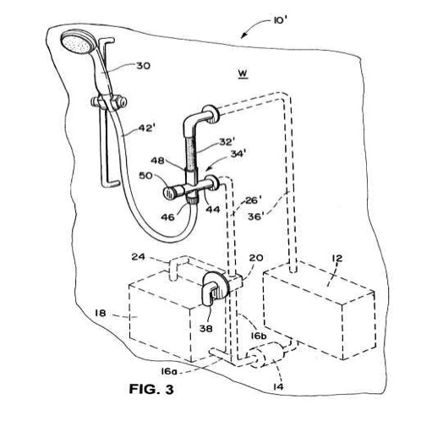
What we are doing.

Slide 3
Notice: Two requirements to install the SHOWERMI$ER system.
Results you can see!
1) You MUST be able to make connections to the non-pressurized side for the system to work properly.
2) You must be able to get to the inside wall behind your shower where the plumbing is located.
Contact your local dealer for installation assistance.

Slide 4
Tools/Items Needed
Results you can see!
Power Drill
Hole Saw 13/16 inch drill bit (NOT 7/8 inch!)
Crayon or Erasable Marker (any color)
Teflon Tape
Clean Soft White Cloth
Channel Locks
1.0

Slide 5
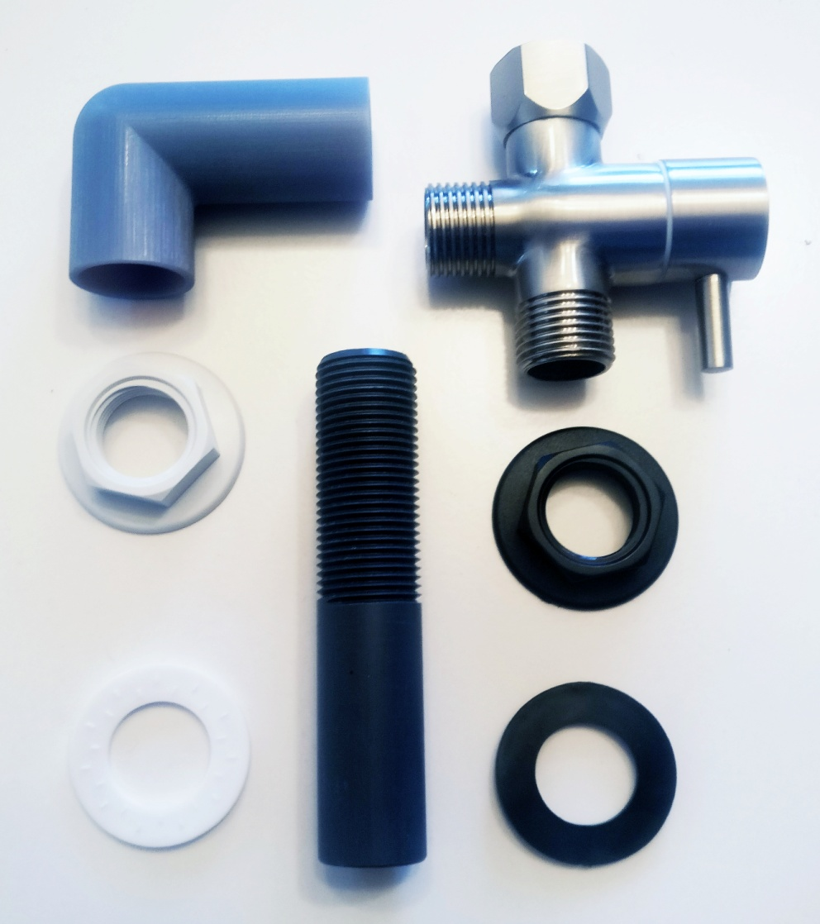
Items Included in Kit
Results you can see!
SHOWERMI$ER Unit
Solid Brass 2 way Diverter
½” Thread /Slip Nipple 74mm long
½” Locknut Washers (2)
½” Locknut (2)
2
1
4
4
3
5
5

Slide 6
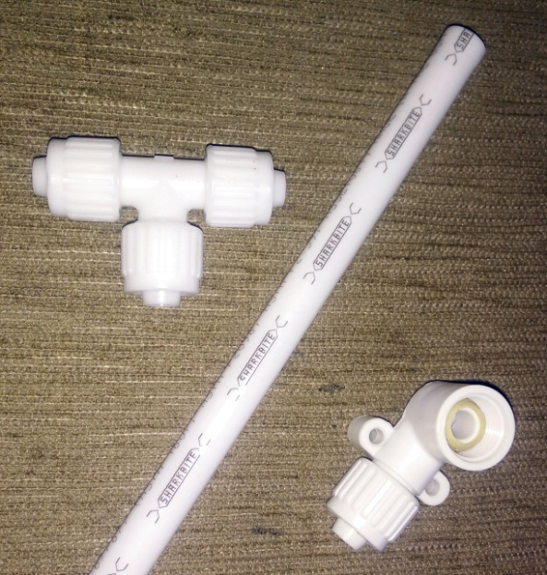
Items Not Included in Kit
Results you can see!
½” Pex Pipe
½” Pex to Female threaded Fitting
Fittings (number of fittings depends on were and what you are connecting) to connect to the non-pressurized side of the water system.
Contact your local dealer for installation parts if needed.

Slide 7
Step 1
Results you can see!
SHOWERMI$ER Elbow connects anywhere on the non-pressurized side of the fresh water system, like the fresh water tank.*
NOTE: The input side of the water pump is NOT recommended.
* Fill Line, Drain Line, or Overflow line are recommended.
Find that location!
Contact your local dealer for installation assistance if needed.
*Water tank may need to be emptied.

Slide 8
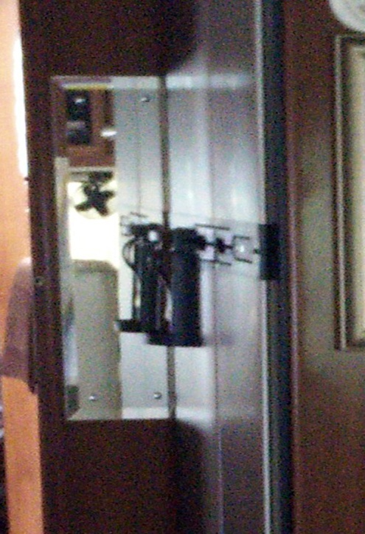
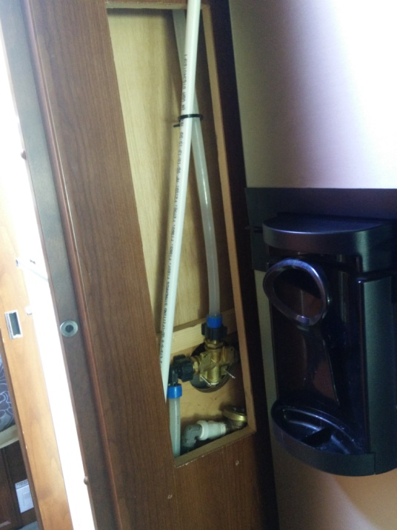
Step 2
Results you can see!
Gain access to the back of the shower where the shower plumbing is installed.
Again, Contact your local dealer for installation assistance if needed.

Slide 9
Step 3
Results you can see!
Determine the length of PEX pipe needed to go from the showerhead to your connection point on the NONPRESSURIZED side of the water system.
Procure the amount of pipe needed and the proper fittings to complete the connections when finished.

Slide 10
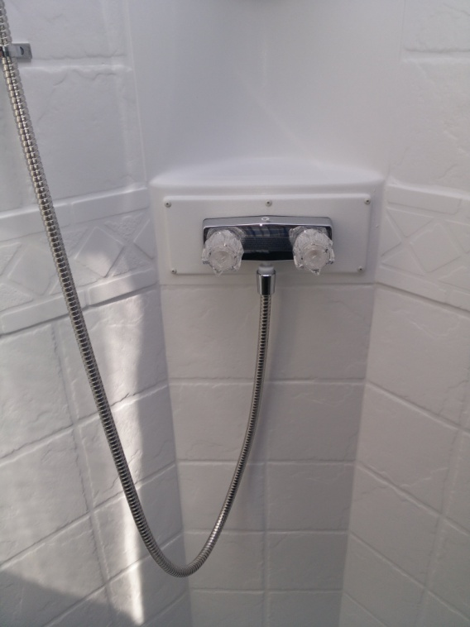
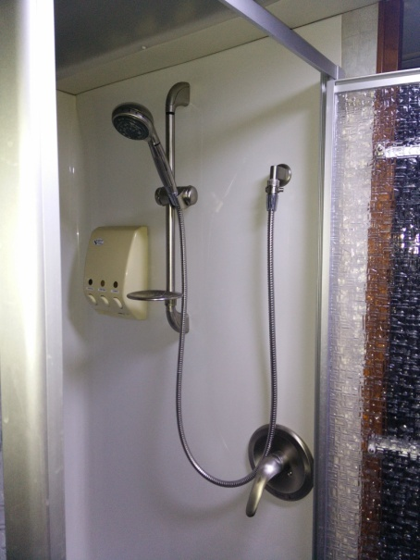
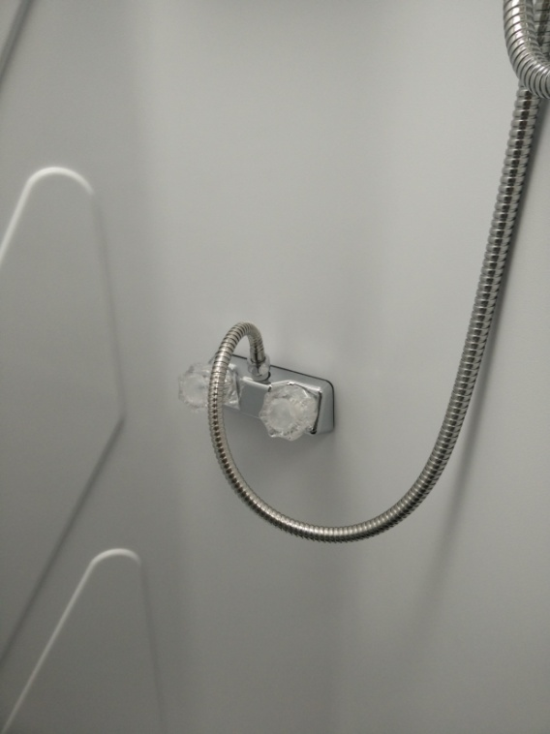
Step 4
Results you can see!
Locate water input point at shower.
See red circles below

Slide 11
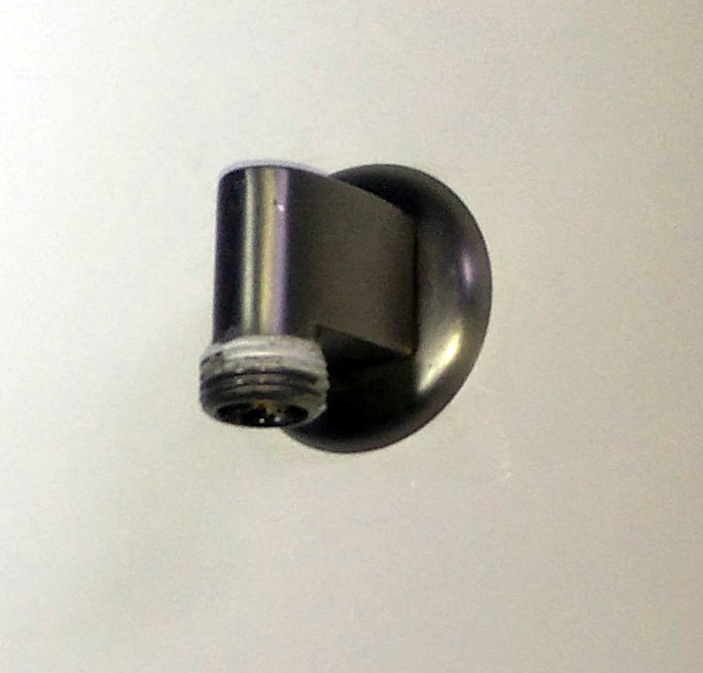
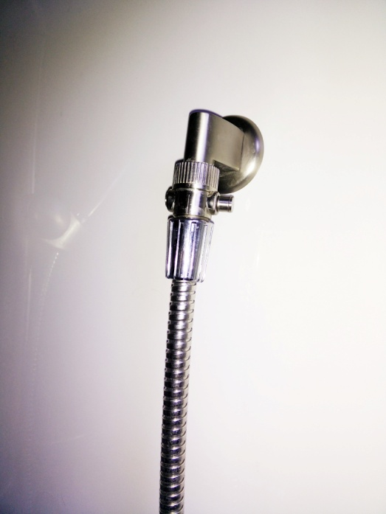
Step 5
Results you can see!
Remove shower head or shower hose from water input pipe.

Slide 12
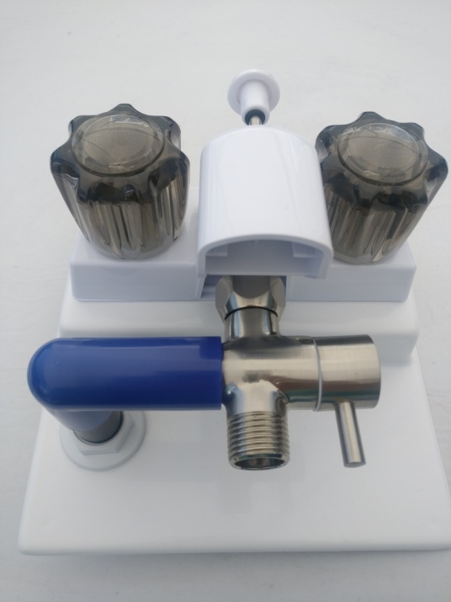
Step 6
Results you can see!
Attach SHOWERMI$ER unit to water input pipe.*
* Note: For left or right side installs diverter lever may be repositioned.

Slide 13
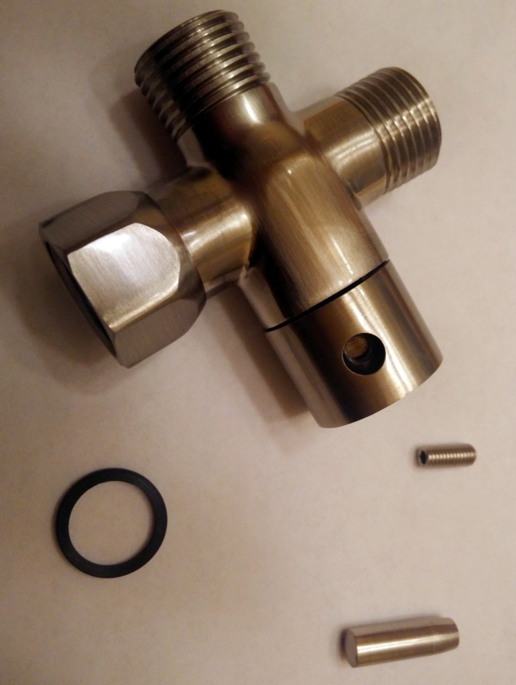
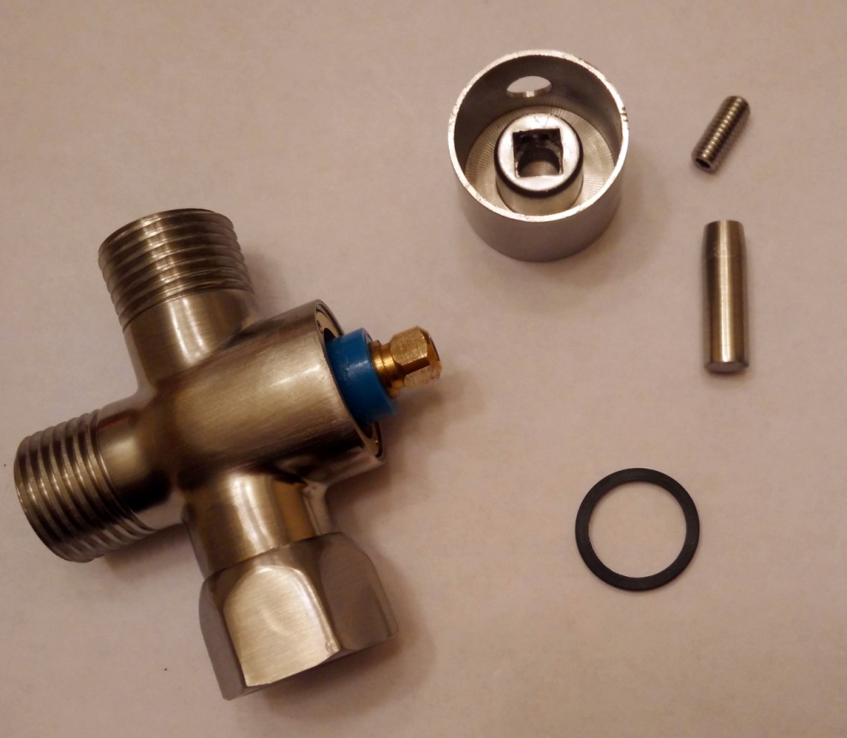
How To Reposition Lever
Results you can see!
For Left side installs diverter lever may be repositioned. The post on the lever unscrews and the Allen screw is loosened to reposition* the lever.
* Note: To reposition, rotate Lever as needed degrees and reassemble.

Slide 14
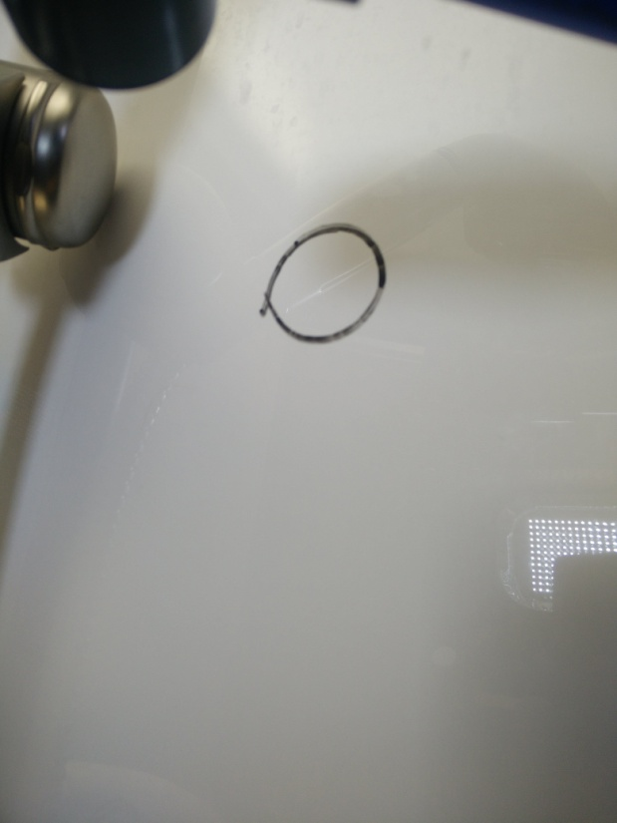
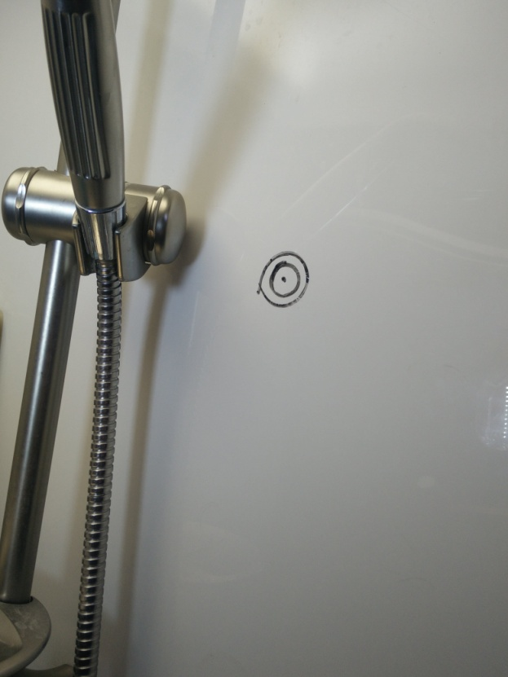
Step 7
Results you can see!
Using Crayon or Erasable Pen locate the center point of 90 Deg Elbow.*
*Be sure SHOWERMI$ER is level

Slide 15
Step 8
Results you can see!
Remove the SHOWERMI$ER unit.
Using a 13/16” inch hole saw drill a hole where the mark had been made at center of Elbow opening.

Slide 16
Step 9
Results you can see!
Apply Teflon Tape on the threaded side of the ½” nipple to make a water tight seal when connecting the through wall fittings together.
Attach ½” x 74mm long nipple (Included in kit) to the slip side of the 90 degree Elbow using clear PVC glue .

Slide 17
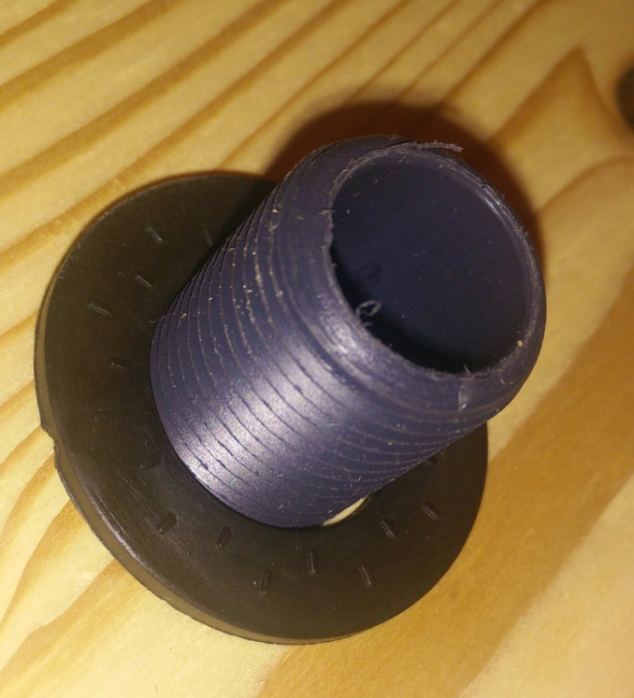
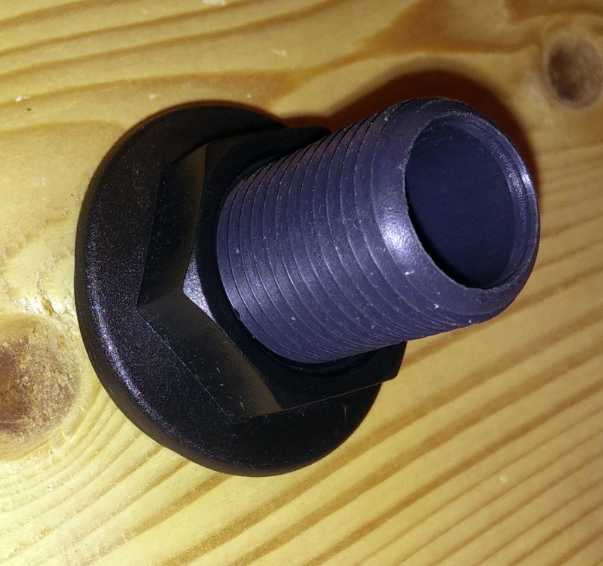
Step 10
Results you can see!
Using the ½” Washers & Locknuts (Included in kit), attach the first set to the Nipple (Nut first and backwards. Screw it all the way until you run out of treads. Then place the washer on and slide it up to the nut. Insert the threaded side of the nipple into the wall with the washer & Locknut to the back of the shower. Hand tighten securely to the shower wall (washer first, then nut).
Do not over tighten!
1
2

Slide 18
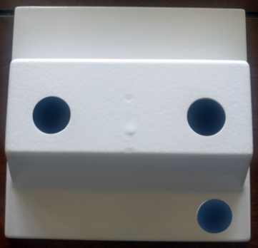
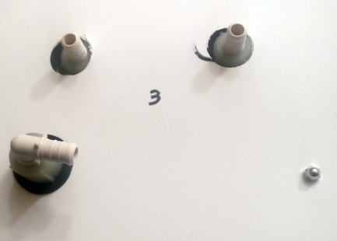
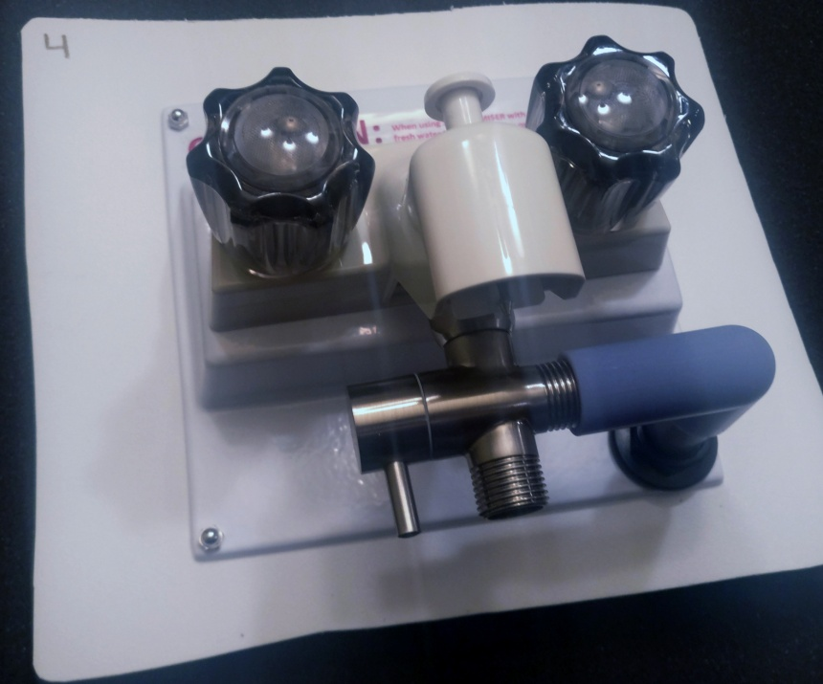
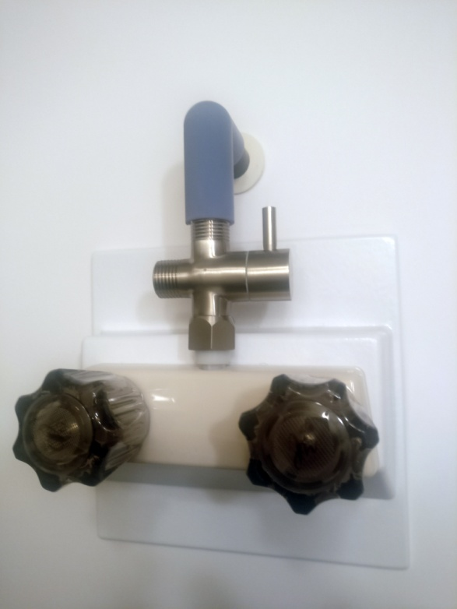
Examples
Results you can see!

Slide 19
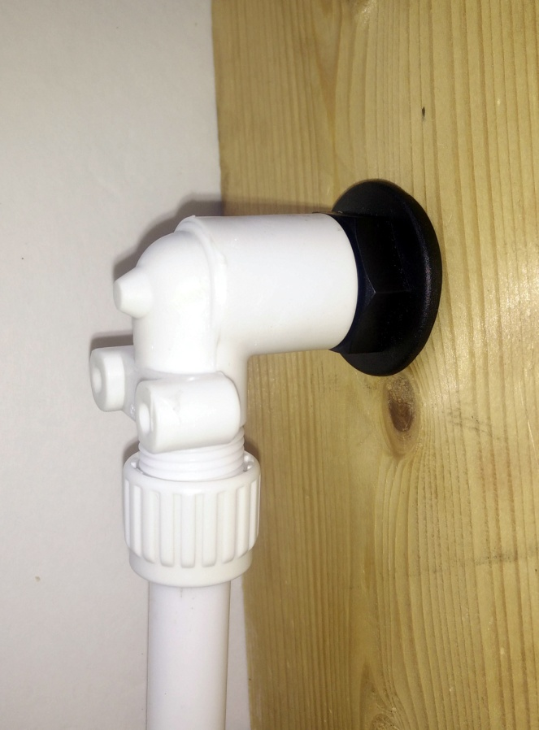
Step 11
Results you can see!
Apply Teflon Tape on to both sides of the ½” All Thread Nipple to make a water tight seal when
Attach the Pex pipe, with a ½” female fitting. Hand tighten securely to the ½” Nipple.

Slide 20
Step 12
Results you can see!
Reattach SHOWERMI$ER unit (with the diverter washer) to shower water input pipe*. Again, use some Teflon Tape to make a water tight seal.
Reattach shower head or shower hose to the SHOWERMI$ER 2 way diverter.
* Don’t forget to insert the diverter washer included with the kit.
1
2

Slide 21
Step 13
Results you can see!
Connect the other side of the Pex pipe to the non pressurized side of the water system you had previously located.

Slide 22
Results you can see!
Test the System
2) Turn on hot water valve to full. If the SHOWERMI$ER lever is in the correct position, no water will come out of shower head.

Slide 23
Results you can see!
Test the System
3) Keep an eye on the Blue portion of the SHOWERMI$ER unit. When the white and blue pin stripes appear the hot water has arrived!
Cold
Hot water
Arrived!
Hot

Slide 24
Results you can see!
Operating the System
4) Turn the SHOWERMI$ER lever to the open position. You now have hot water.
CAUTION! WATER WILL BE HOT! TO AVOID BEING BURNED ADJUST THE HOT AND COLD WATER MIX BEFORE TURNING THE LEVER BACK TO THE SHOWER HEAD.

Slide 25
Results you can see!
Elbow
For technical support call: 714-485-5904

